Slide 1

CEF 488:
INTERNET AND MOBILE PROGRAMMING

Slide 2

TABLE OF CONTENT
INTRODUCTION
DESIGN IMPLEMENTATION
SUMMARY

Slide 3

INTRODUCTION
1

Slide 4

No one has ever become poor by giving.
Anne Frank

Slide 5
DESIGN
2

Slide 6

DESIGN
We used AdobeXD to design the different interfaces of the application.
As far as the interfaces are concerned, we designed the following interfaces.

Slide 7
INTERFACES
Login
Registration
Profile
Home
Forum
About

Slide 8

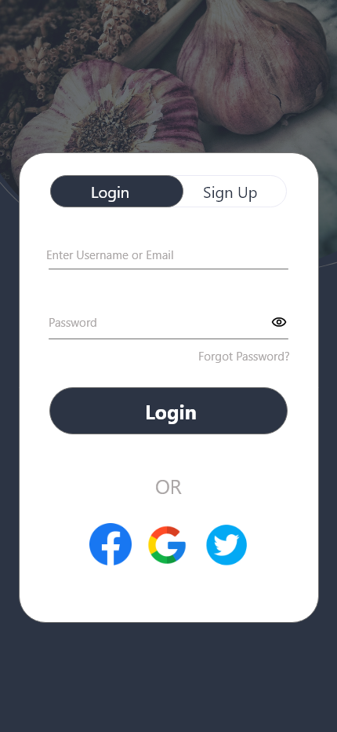

LOGIN
Here, the user enters his credentials and login into his account.

Slide 9
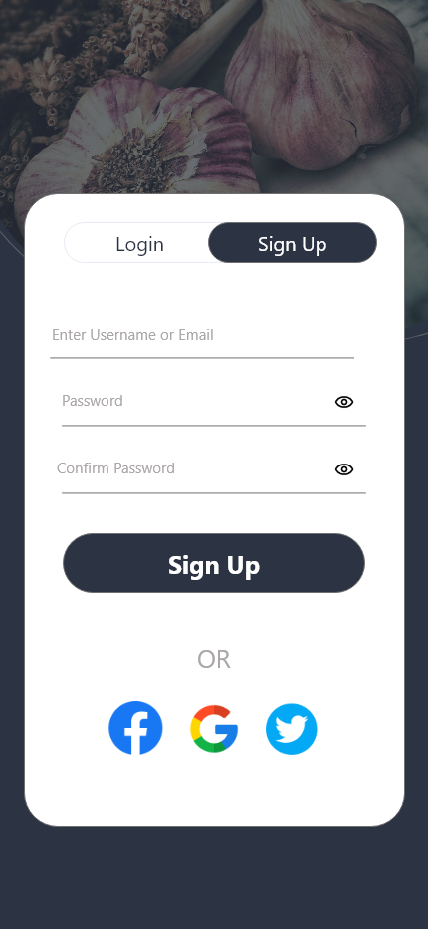
REGISTRATION
Users without accounts can register by entering and their personal informations and become members of the food app community

Slide 10
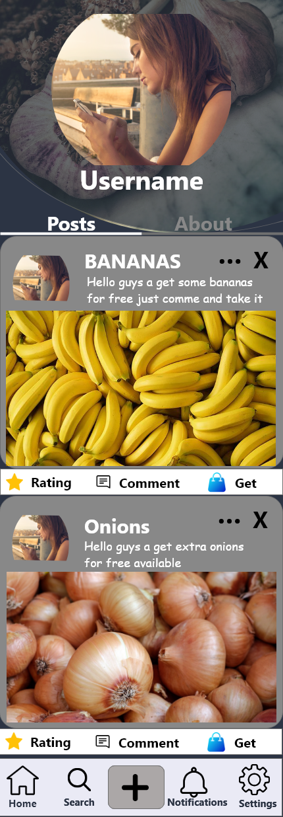
PROFILE
Here, the user can view his informations and he has the possibility to modify the.
Also, the use can view his recent posts.

Slide 11
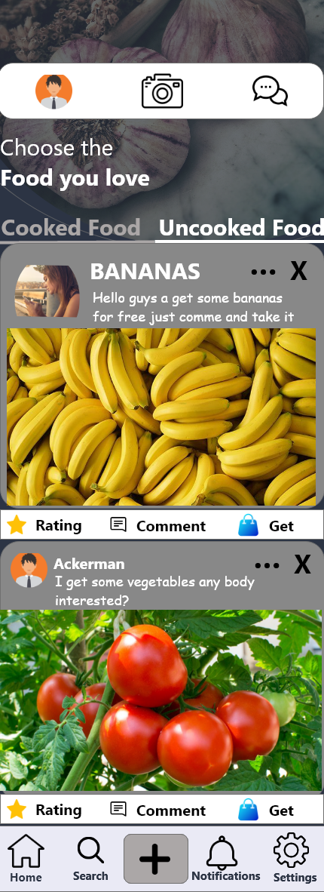
HOME PAGE
This is the page after login, where the user can view recent posts and eventually request for food.

Slide 12
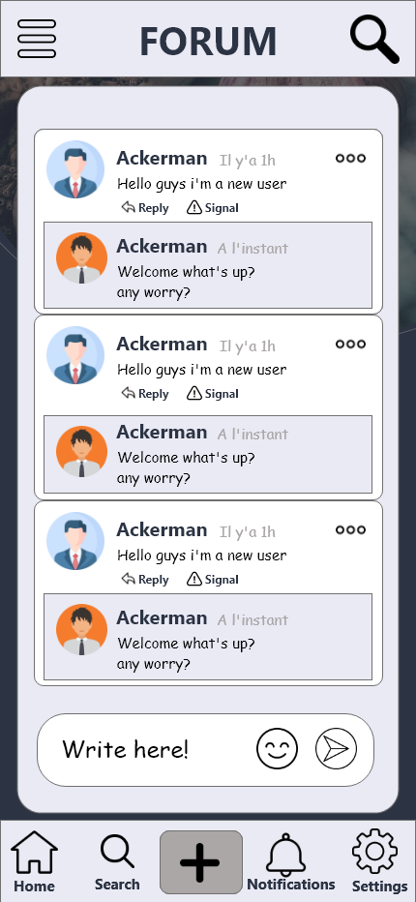
FORUM
This is a platform where each user can communicate with the other.

Slide 13
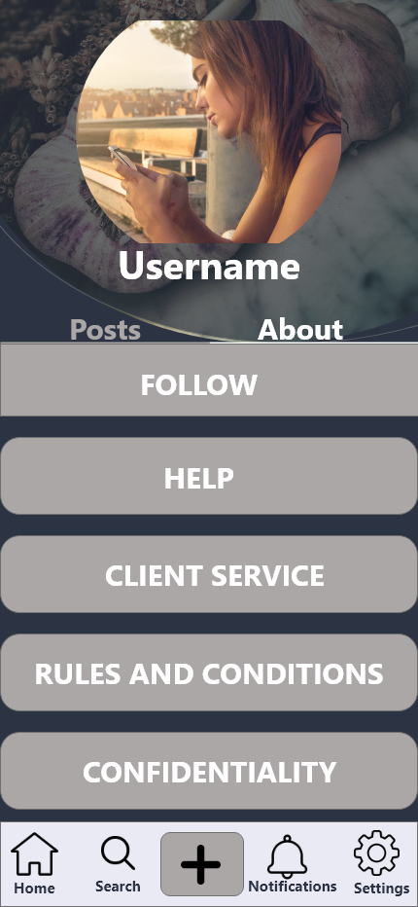
ABOUT
This is a platform which guide the user and help in answering Frequently Asked Questions

Slide 14
IMPLEMENTATION
3

Slide 15
IMPLEMENTATION
After the design phase, we used REACT NATIVE and Visual Studio Code in order to code the different interfaces and produce a the Native application.

Slide 16

IMPLEMENTATION
In order to run the code, we used an iOS device and an application known as Expo client go.
Free on Play Store.

Slide 17
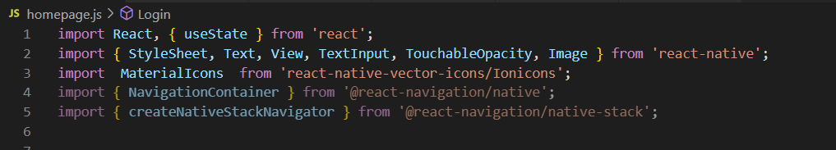
LIBRARIES
We installed the react Native Libraries with the command
Npm install expo-cli –-global

Slide 18
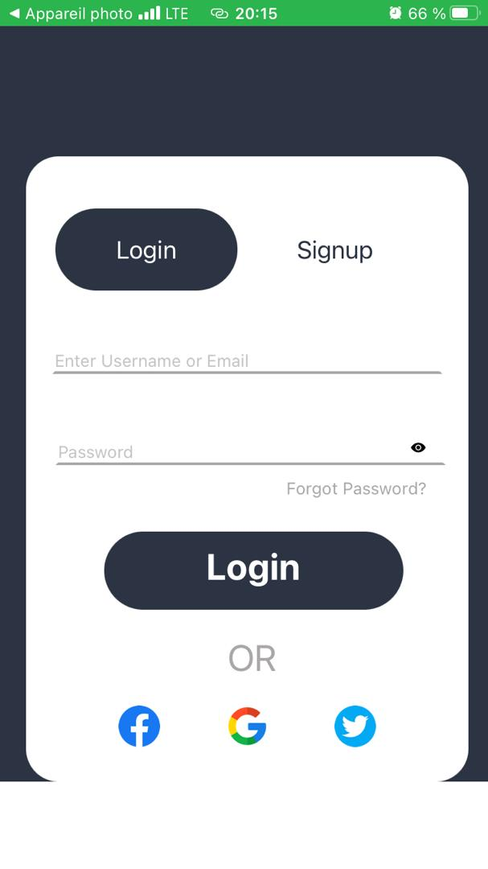
LOGIN PAGE

Slide 19

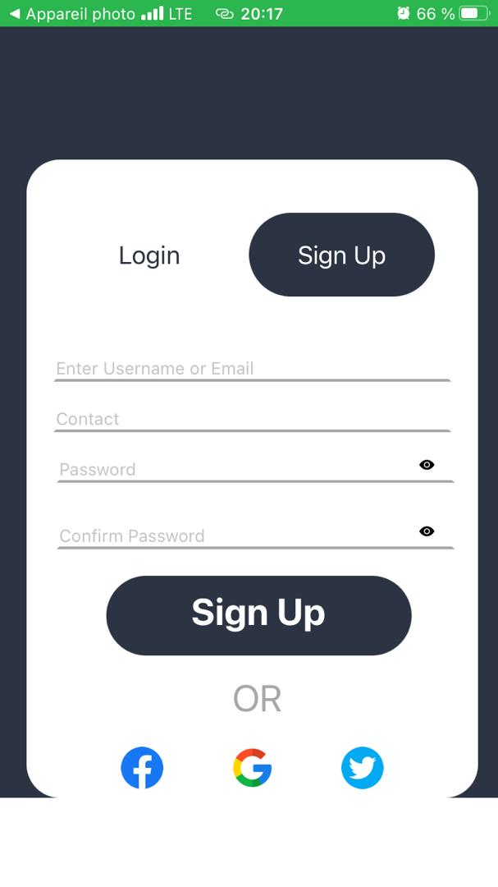
Sign UP

Slide 20
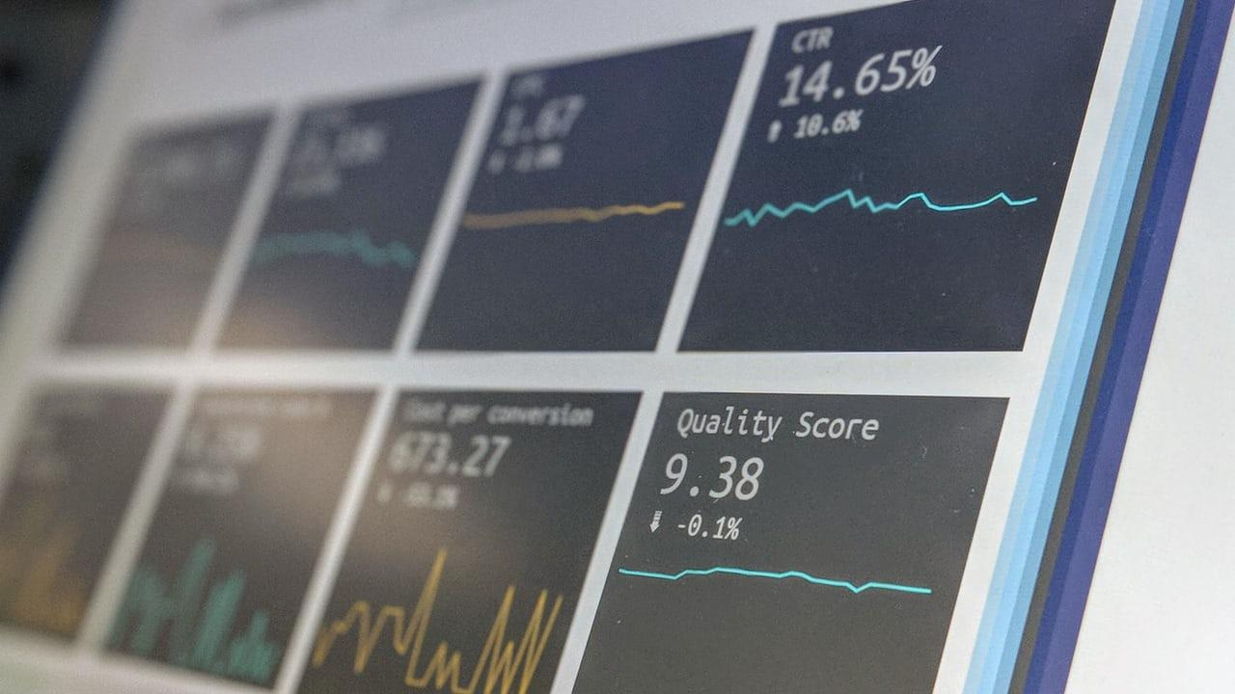
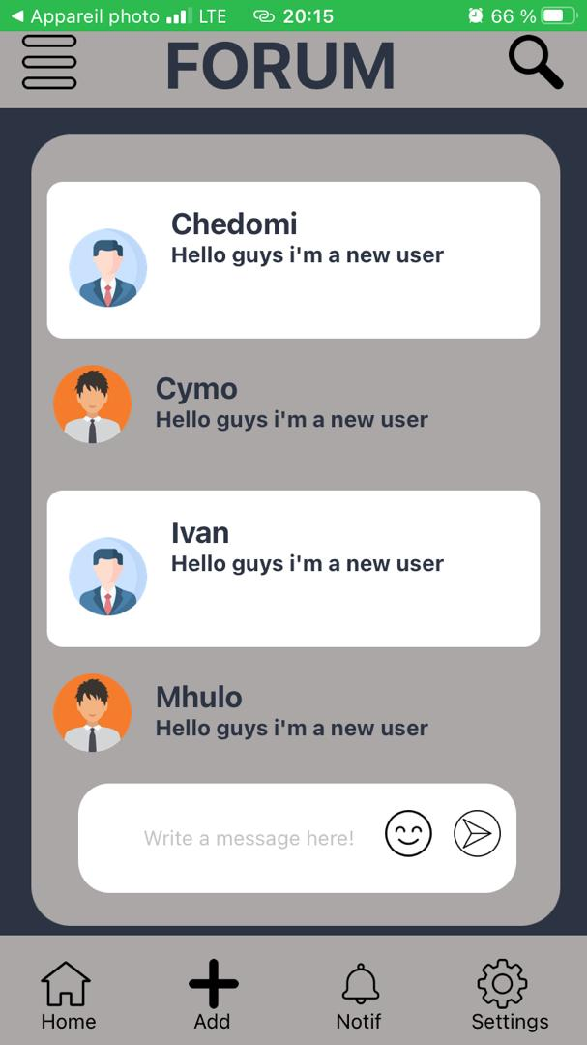
Forum

Slide 21

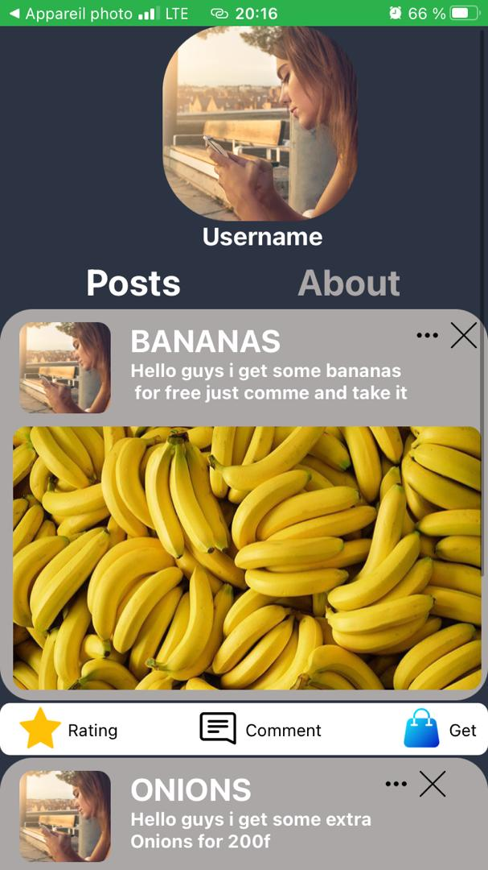
Username
Place your screenshot here

Slide 22
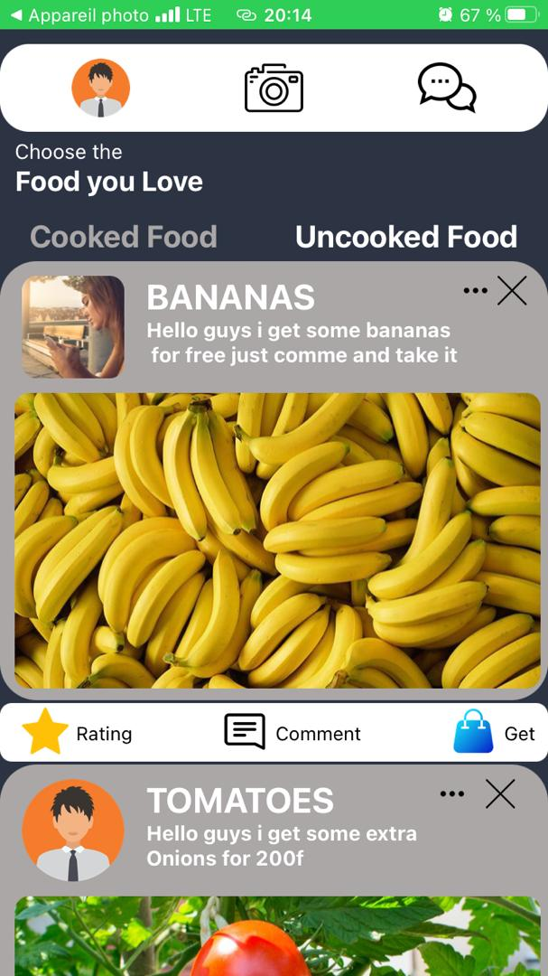
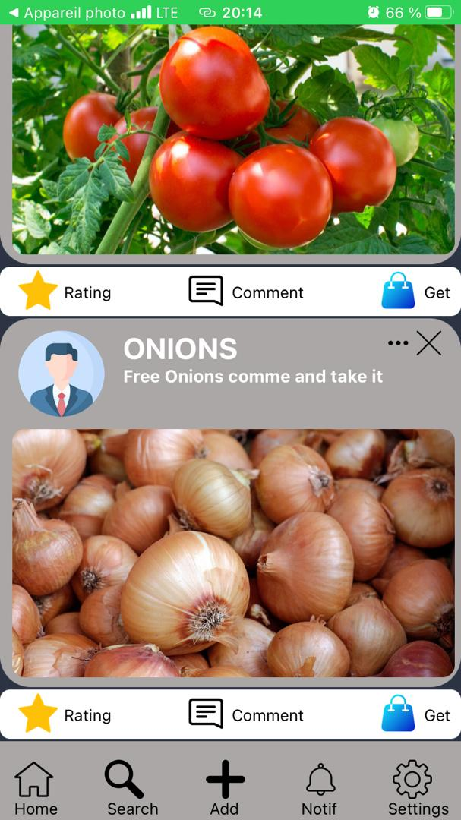
Choose Food
Place your screenshot here

Slide 23
Posts
Place your screenshot here

Slide 24
THANKS!
Any questions?
You can find us at:
*https://github.com/cybelle715
24

